Slide 1

INSTITUTE: UIE (AIT-CSE)
Computer Networks CST- 335
TCP Versus UDP,
SERVICE MODEL
By : Dr.Monica Luthra(E9836)
DISCOVER . LEARN . EMPOWER

Slide 2

Course Objectives
CO Number | Title | Level
CO1 | To bring together several keys to Computer Network Design and Architecture. | Remember
CO2 | To recognize the key concepts of Internetworking. | Understand
CO3 | To prepare a sample Network via Simulation. | Understand

Slide 3
Course Objectives
CO Number | Title
CO1 | Describe the important networking concepts
CO2 | Understand concept of network reference models and protocols
CO3 | Apply the concepts of routing algorithms on various networks
CO4 | Identify mechanism to handle traffic and control on congestion
CO5 | Identify and understand connection establishment techniques and features

Slide 4
Table of Contents
TCP Versus UDP
SERVICE MODEL

Slide 5

Introduction to TCP
TCP (Transmission Control Protocol) was specifically designed to provide a reliable end-to-end byte stream over an unreliable internetwork.
An internetwork differs in terms of different topologies,
bandwidths, delays, packet sizes, and other parameters.
Each machine supporting TCP has a TCP transport entity, either a
library procedure, a user process, or part of the kernel.
TCP service is obtained by both the sender and receiver creating end points, called sockets. Each socket has a socket number (address) consisting of the IP address of the host and a 16-bit number local to that host, called a port.
Port numbers below 1024 are called well-known ports and are
reserved for standard services.

Slide 6
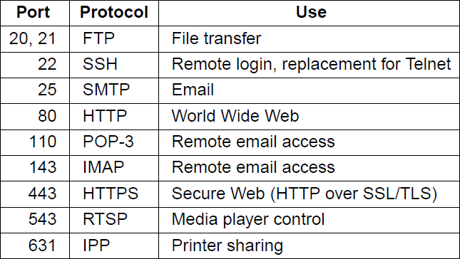
The TCP Service Model
Some assigned ports

Slide 7
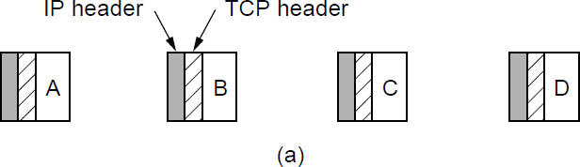
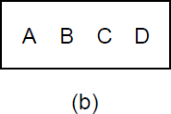
The TCP Service Model
(a)Four 512-byte segments sent as separate IP diagrams (b)The 2048 bytes of data delivered to the application in a
single READ call

Slide 8
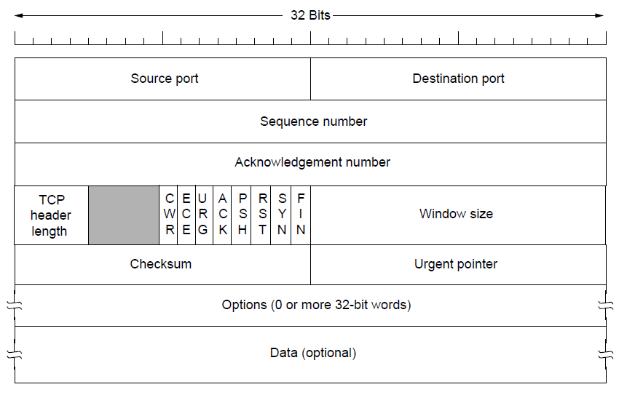
The TCP Segment Header
The TCP header.

Slide 9
The TCP Segment Header
TCP connection has its own 32-bit sequence number.
Separate 32-bit sequence numbers are used for acknowledgements.
The sending and receiving TCP entities exchange data in the form of
segments.
A TCP segment consists of a fixed 20-byte header (plus an optional part)
followed by zero or more data bytes.
The TCP software decides how big segments should be.
Two limits restrict the segment size.
First, each segment, including the TCP header, must fit in the 65,515-byte
IP payload.
Second, each network has a maximum transfer unit, or MTU. In practice, the MTU is generally 1500 bytes and thus defines the upper bound on segment size.

Slide 10
TCP Working
The basic protocol used by TCP entities is the sliding window protocol.
When a sender transmits a segment, it also starts a timer.
When the segment arrives at the destination, the receiving TCP entity sends back a segment (with data if any exist, otherwise without data) bearing an acknowledgement number equal to the next sequence number it expects to receive.
If the sender's timer goes off before the acknowledgement is received, the sender transmits the segment again.

Slide 11
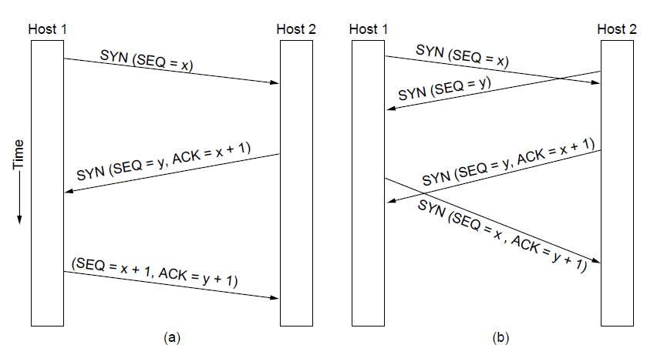
TCP Connection Establishment
TCP connection establishment in the normal case.
Simultaneous connection establishment on both sides.

Slide 12
TCP Connection Release
To release a connection, either party can send a TCP segment with the FIN bit set, which means that it has no more data to transmit.
When the FIN is acknowledged, that direction is shut down for new data.
Data may continue to flow indefinitely in the other direction, however. When both directions have been shut down, the connection is released.

Slide 13
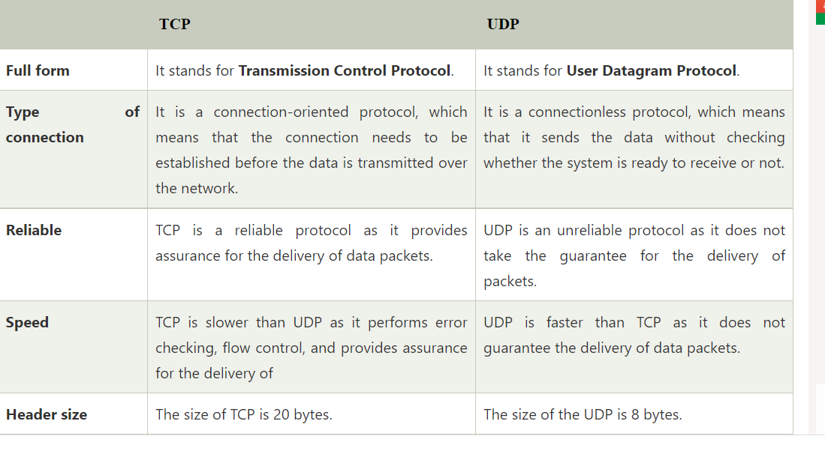
TCP versus UDP

Slide 14
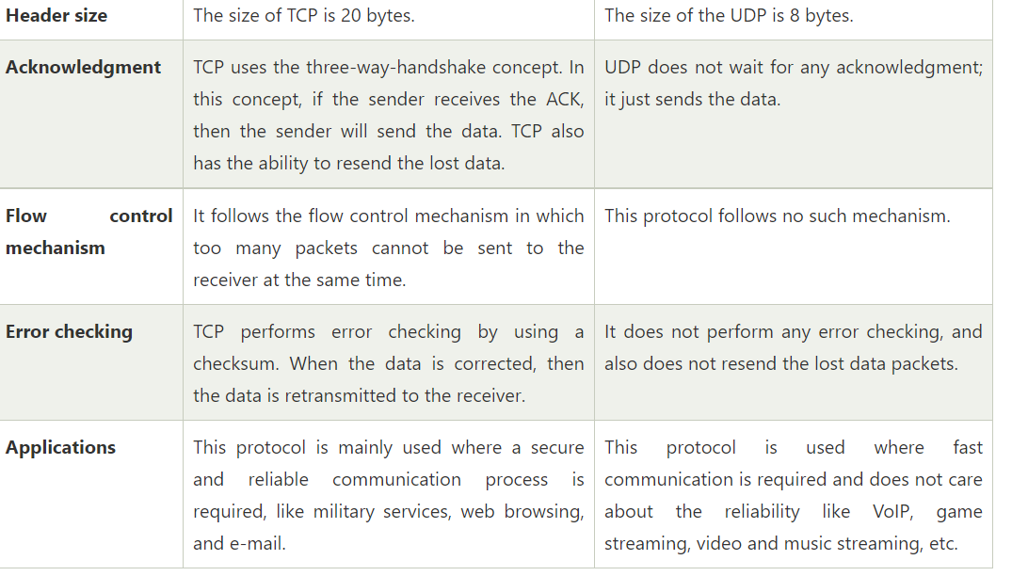
TCP versus UDP

Slide 15
References
https://en.wikipedia.org/wiki/Leaky_bucket
https://www.geeksforgeeks.org/leaky-bucket-algorithm/
https://en.wikipedia.org/wiki/Token_bucket
https://www.ques10.com/p/31441/what-is-traffic-shaping-explain-leaky-bucket-algor/

Slide 16
THANK YOU
For queries
Email: monica.e9836@cumail.in

